Slide 1


Data Analytics Using Tableau
(A Step Towards Data Science)

Slide 2
WHAT IS DATA ANALYTICS?
Data Analytics:
‘Is a process of inspecting, cleansing, transforming and modelling data with the goal of discovering useful information, suggesting conclusions and supporting decision-making’. -Wikipedia
‘Leverage data in a particular functional process (or application) to enable context-specific insight that is actionable’. -Gartner
‘Is using our current data sets to extract useful information to support advanced decision making’. –ATC (American Tower Corporation)
Data Visualisation:
Provides a visual context of data using dashboards
Is often a single-page, real-time user interface and is the graphical presentation of your data

Slide 3
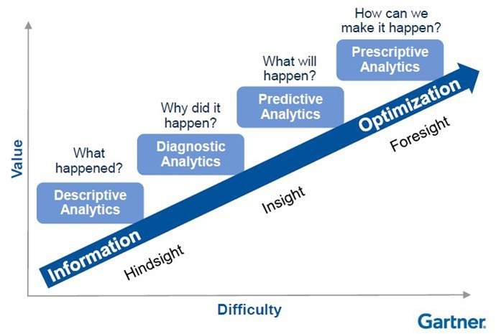
DATA ANALYTICS CAPABILITIES

Slide 4
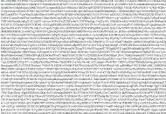
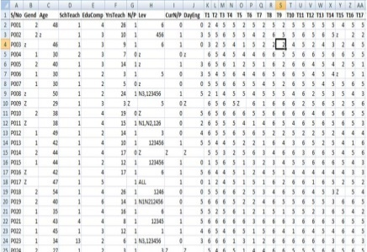

DATA ANALYSIS
Data analysis is the process of:
Compiling and analysing data for decision-making, and
Generating real-time outcomes.
Raw data
Compiled data
Insights

Slide 5

WHY DATA VISUALISATION ?

Slide 6

The textual nature of data can be improvised by adding visualisation methods.

Slide 7
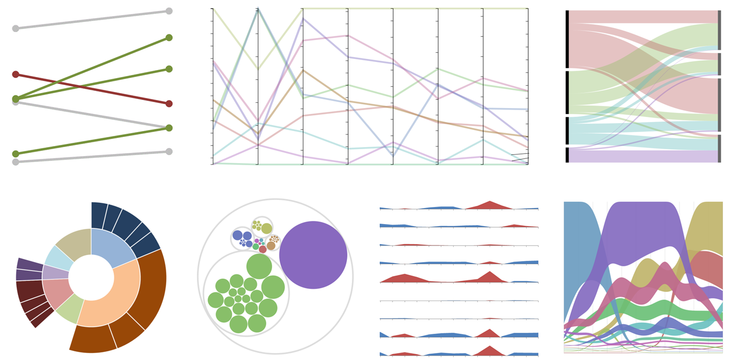
HUMANS ARE GOOD AT UNDERSTANDING VISUAL PATTERNS

Slide 8
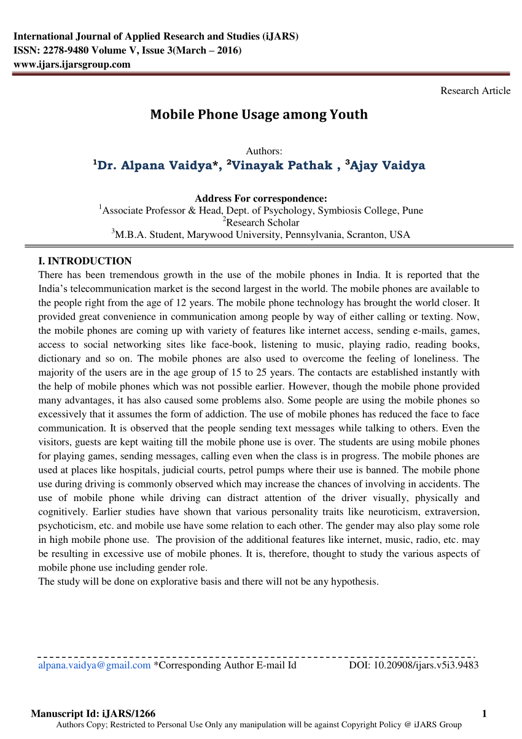
WHAT INSIGHTS CAN YOU GET FROM THE TEXT GIVEN BELOW?

Slide 9
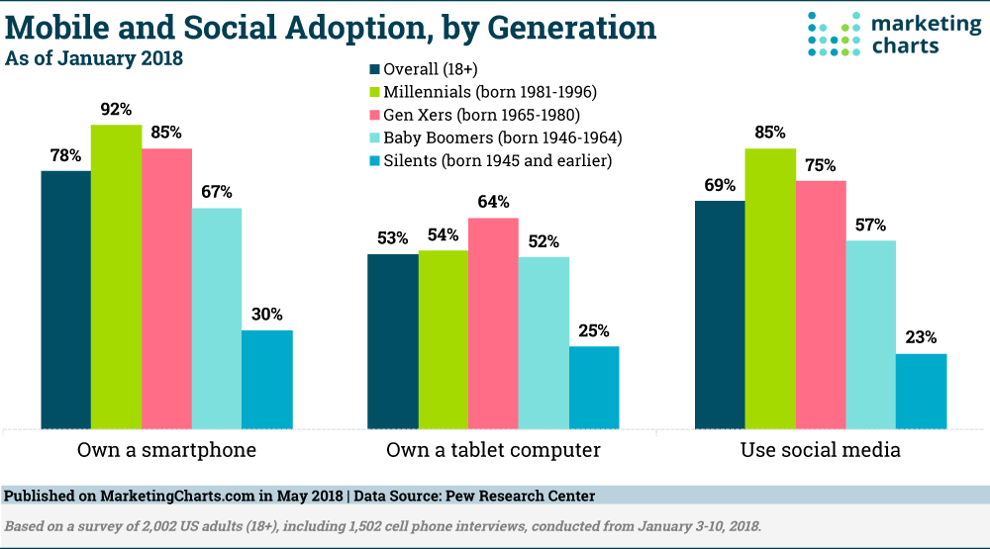
WHAT INSIGHTS CAN YOU GET FROM THE CHARTS GIVEN BELOW?

Slide 10

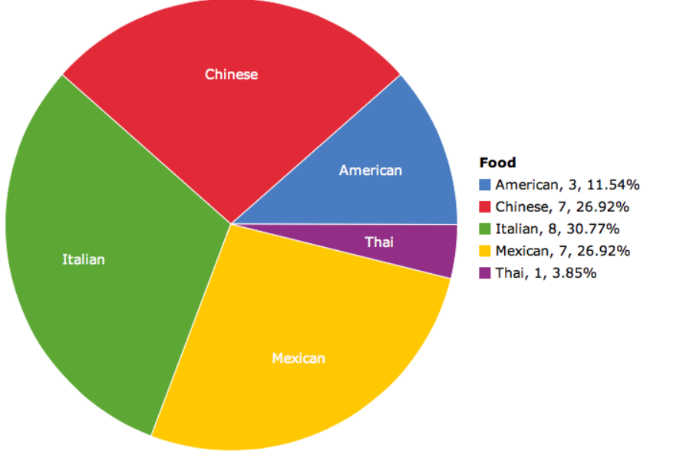
DATA VISUALISATION IS THE BEST WAY TO CONVEY CONCEPTS

Slide 11
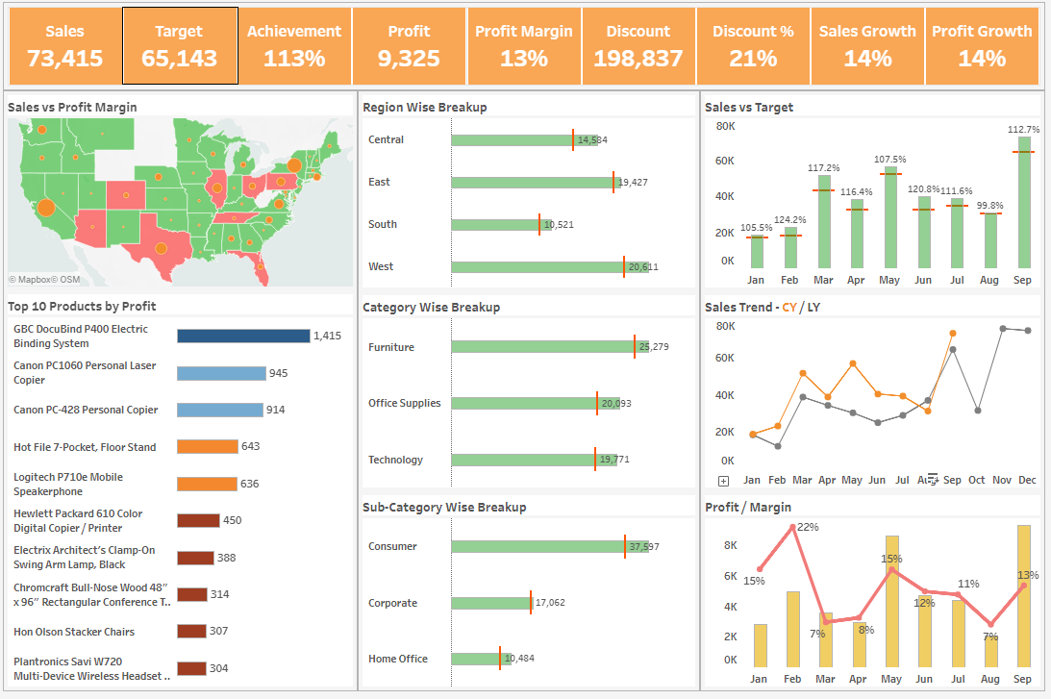
IT PROMPTS CREATIVE DATA EXPLORATION
Financial Overview Dashboard

Slide 12

Data visualisation
Data visualisation deals with the presentation of your data in the form of charts, pictures or graphs to the appropriate people at the correct time in order to enable them to gain insights most effectively.

Slide 13
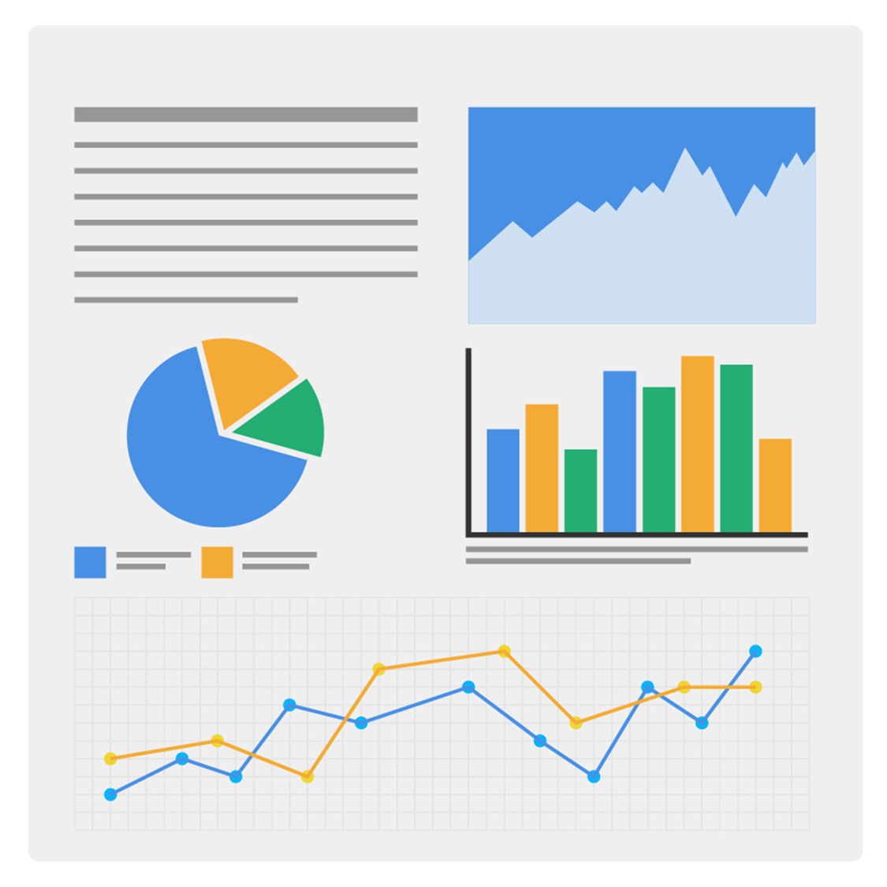
Data visualisation
Provides insights into complex data sets
Communicates the key aspects of the data sets in a meaningful way
Provides the required information in an easy way
Is the best platform for presentation

Slide 14


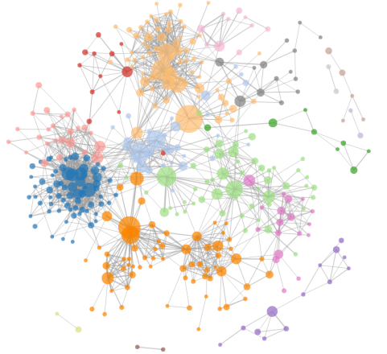
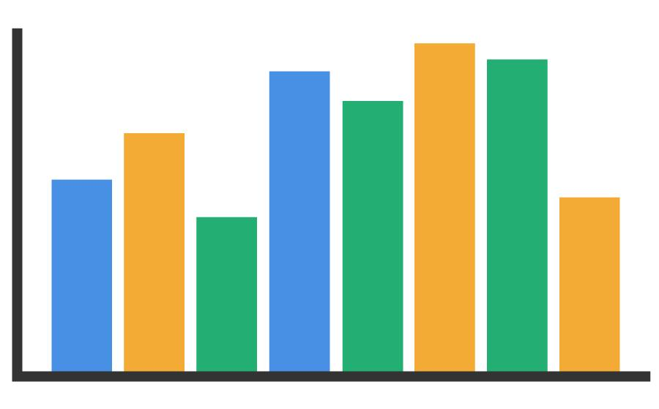
How Will You Distinguish Parameters in Visualisation ?
Color
Shape
Size
Proximity

Slide 15
“
‘A tool is only as good as the user’
Hence, let’s focus on various data visualisation techniques.
“
- Anonymous

Slide 16






DATA VISUALISATION TOOLS
Tableau
QlikView
FusionCharts
Highcharts
DataWrapper
Power BI

Slide 17
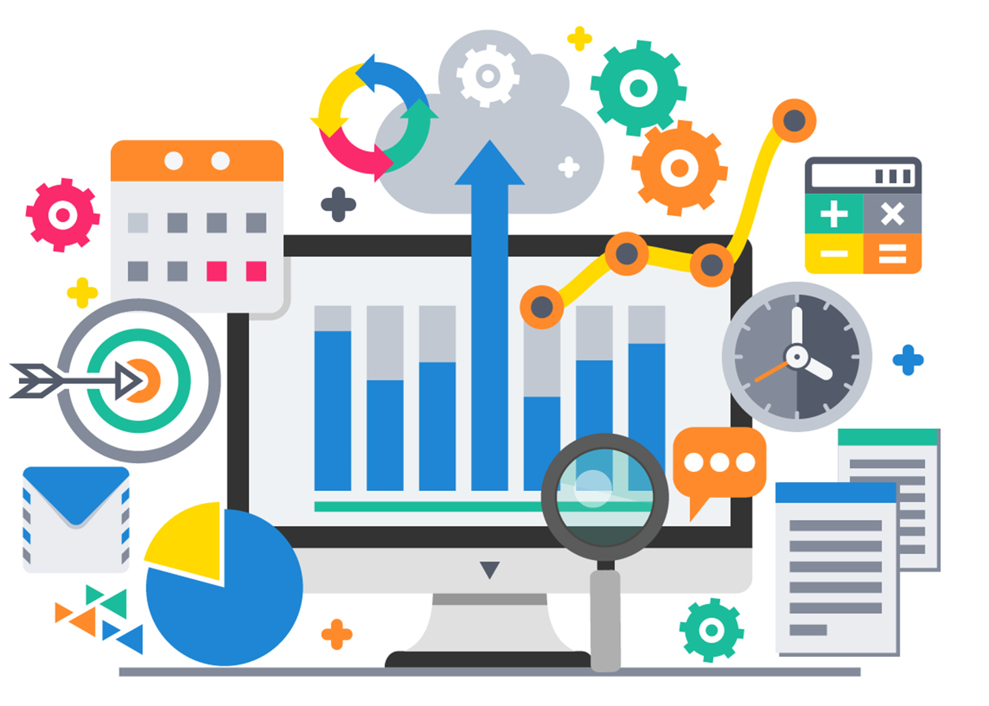
Tableau
It is a data connect and data analysis tool used for visualisation.

Slide 18

Key Features
Tableau is a business intelligence and data visualisation tool.
It is easy to learn: Has a simple drag-and-drop-based interface.
It has interactive dashboards.
It can share and interact.
Its implementation is easy and enables real-time collaboration with fellow team members.
It enables smart data connect over Cloud.

Slide 19
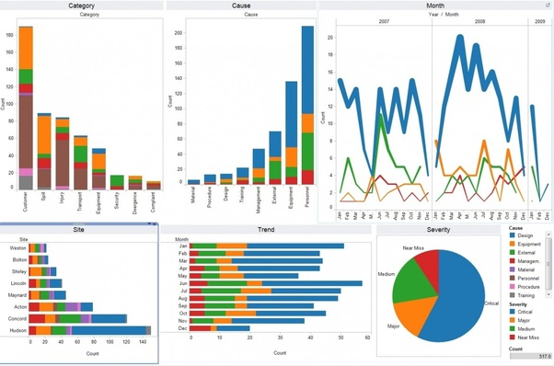
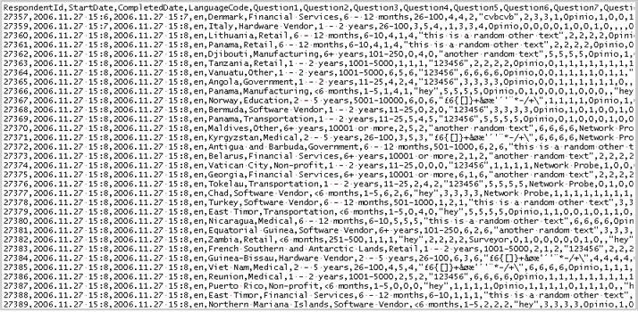
VISUALISATION WITHOUT CODING

Slide 20
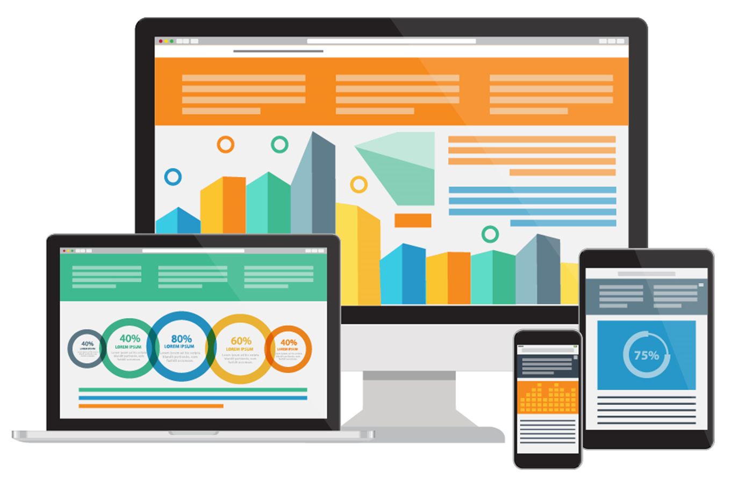
A PLETHORA OF COMPANIES USE TABLEAU FOR BI

Slide 21
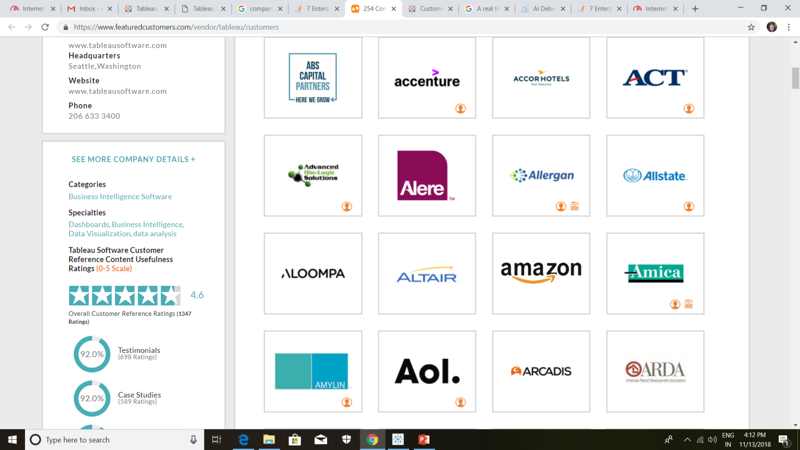
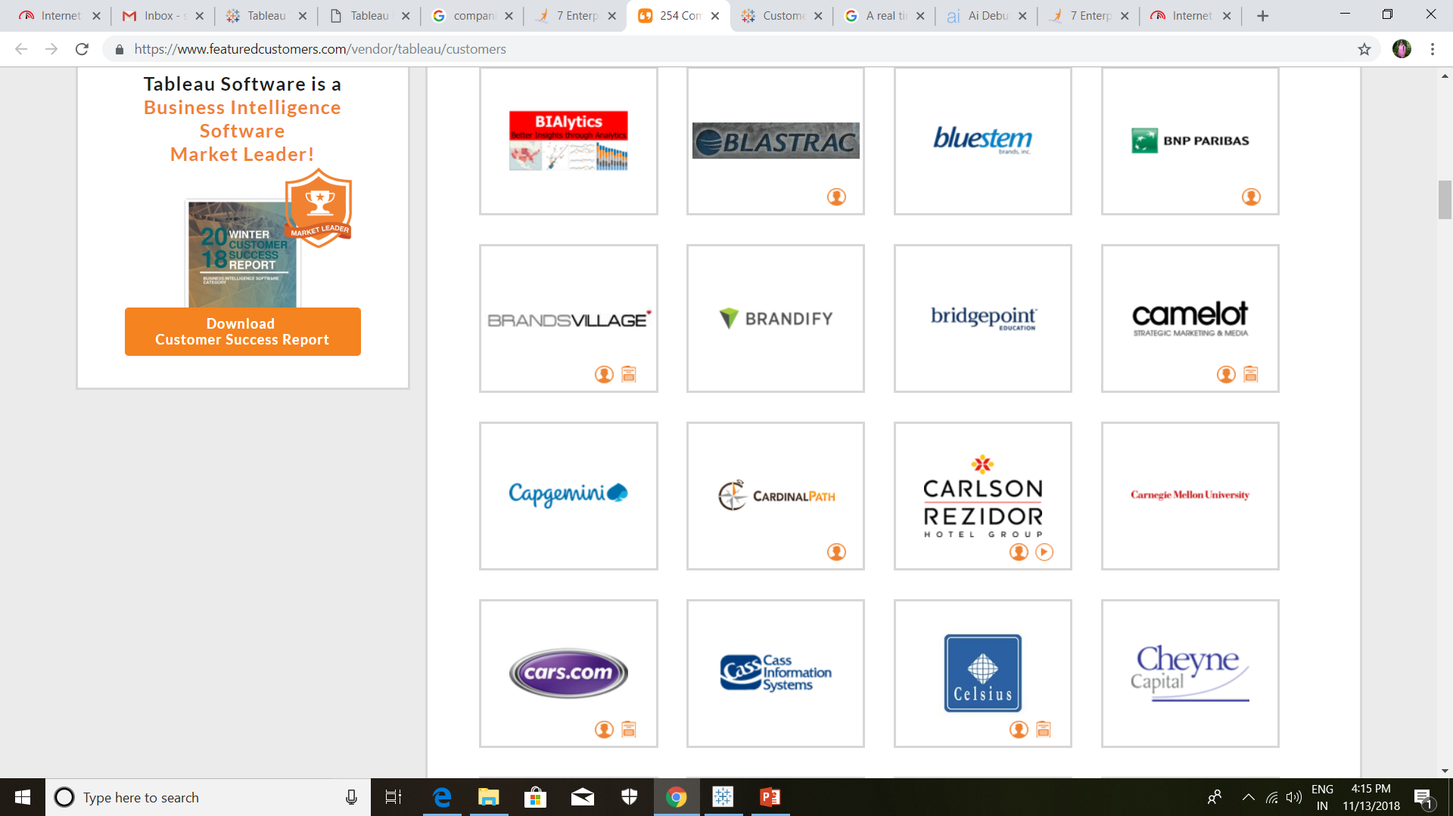
FEATURED COMPANIES THAT USE TABLEAU

Slide 22





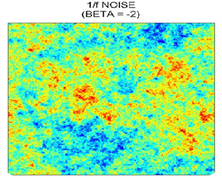
EASY DATA INTEGRATION: FILES

Slide 23





EASY DATA INTEGRATION: SERVERS

Slide 24






TYPES OF TABLEAU
Desktop
Public
Tableau
Online
Reader
Server

Slide 25
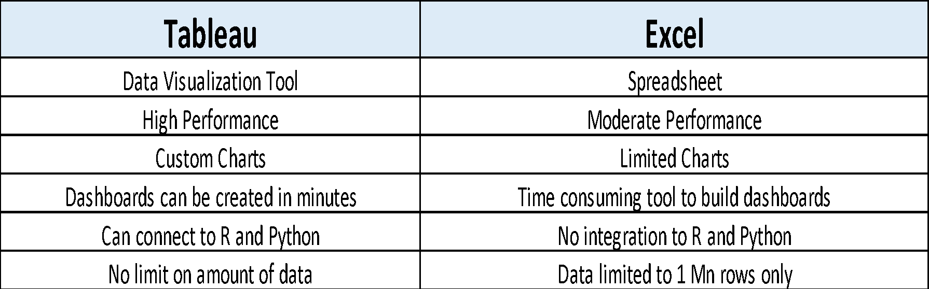
TABLEAU VS EXCEL

Slide 26
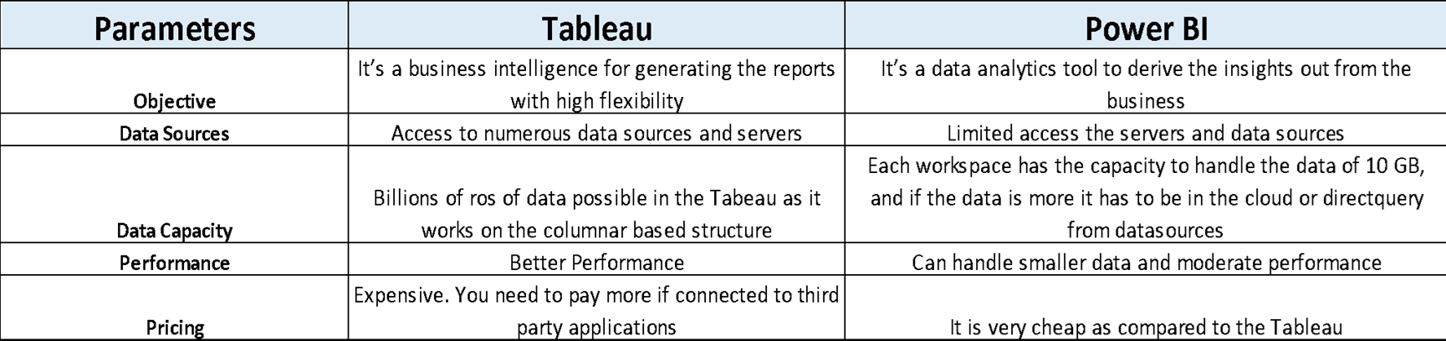
TABLEAU VS POWER BI

Slide 27
EXPLORATORY VS EXPLANATORY ANALYSIS
Exploratory analysis:
Exploratory analysis is often the first step of data analysis. Here we get familiar with data, ask questions, visualise the data in a number of forms, look for relationships between the variables, look for outliers, patterns and trends in data. The output of exploratory analysis is usually only for us, the data analysts.
Explanatory analysis :
Explanatory analysis is what happens when we have identified some interesting observations in the data. We then create the visuals to present our findings. The output of an explanatory analysis is generally for the public.

